Slide 1
Walbro IMDS/CDX Instructions
How to Register your Company and Log in
IMDS MDS Types (Components, Semi-components, Materials)
How to Create a Component
How to Create a Semi-Component
How to Create a Material
How to Submit MDS to Walbro

Slide 2
How to Register your Company in IMDS/CDX
IMDS
Go to: www.mdsystem.com and click Login
CDX
Go to: www.cdxsystem.com and click CDX Login

Slide 3
How to Register your Company in IMDS/CDX
Click on “Register your Company” and complete the fields and click “Next”. (Only register once you have confirmed that your company is not already registered.)
A window will open asking you to confirm the registration request (IMDS) or if Login should be created (CDX)
Once confirmed, your IMDS/CDX Credentials will be displayed: Copy your credentials and store them in a safe place as they will not be displayed again.
You will receive an e-mail containing a link to activate your new company in IMDS/CDX. You will need to use this URL to activate the company before you can log into IMDS/CDX. If you do not receive an e-mail, please check your Junk/Spam folders.
Click the URL link from the e-mail to open up the Activation window. Click “Activate” to complete the registration.

Slide 4
How to Log into IMDS/CDX
IMDS
Go to: www.mdsystem.com and click Login
Enter your User ID and Password and click Login
CDX
Go to: www.cdxsystem and click CDX Login
Enter your User ID and Password and click Login
Note: After logging in for the first time, you will be prompted to read and accept the Terms of Use and to change your password.

Slide 5
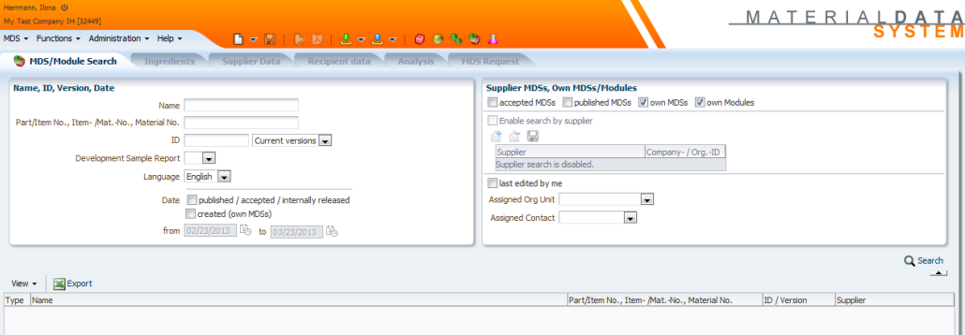
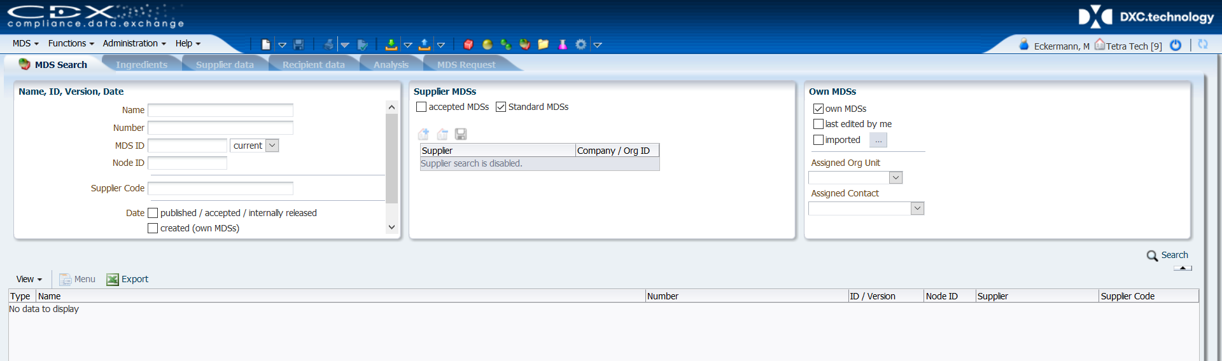
How to log in in IMDS / CDX
Once logged in, you will see the main primary screen
IMDS
CDX

Slide 6
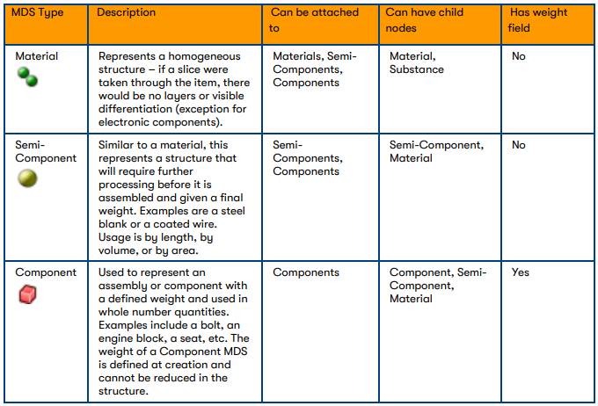
IMDS/CDX Material Data Sheet (MDS) Types
The following symbols represent the building blocks of your product in IMDS/CDX.

Slide 7
Datasheet Types - Definitions
Basic Substance –already loaded in IMDS/CDX
all known elements and chemicals identified with a unique CAS#
also includes “pseudo-substances” associated with polymeric materials for which no specified CAS# is necessary, i.e. PP, ABS, PET, etc.
creation of new basic substance is not permitted or functionally possible; contact DXC.technology IMDS/CDX Service Center
Material – raw, nonfunctional materials; comprised of Basic Substances
can be created “internally” by companies, submitted by your supplier or “published” in IMDS (such as by the IMDS-Committee) or in CDX (such as a Standard MDSs)
Examples of materials: steel, brass, rubber, adhesive, epoxy, coating

Slide 8
Datasheet Types – Definitions (cont.)
or
Components – functional part or assembly within a product; has a defined weight when manufactured by supplier and as incorporated into the next assembly step by customer; created from one or more Materials which define the weight of the part (10g bolt = 10g steel)
e.g. clip, grommet, bolt, seat assembly, engine assembly
Semicomponent – is NOT a “sub-component” in IMDS; a functional part within a product; final weight in an assembly is only defined when it is further processed to size by the customer, not supplier; created from one or more Materials
e.g. roll of tape, roll of Velcro, spool of electrical wire

Slide 9
How to Create a Component in IMDS/CDX – STEP 1
Click the white Page icon and select > Datasheet (IMDS) > Component
Or select MDS > New > Datasheet (IMDS) > Component from the top banner menu options.

Slide 10
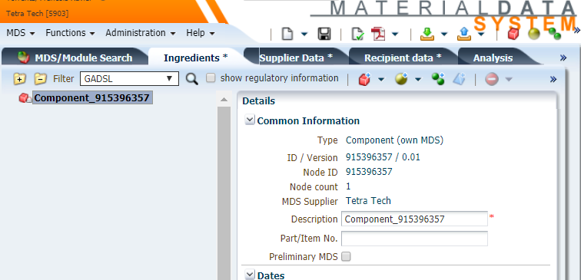
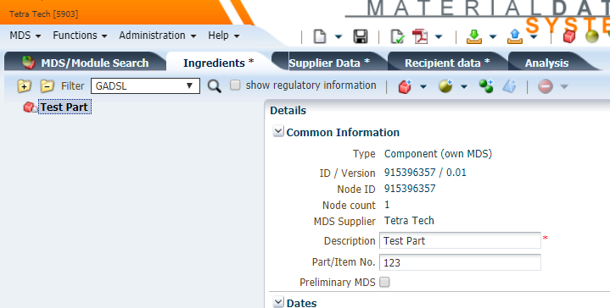
How to Create a Component in IMDS/CDX – STEP 2
Enter the Part Name in the “Description” field.
Click in the “Part/Item No.” field to enter your component Company Part Number.
CDX – Note: Several part numbers can be assigned to a single datasheet. This is for part families when the weights and materials are identical.
Enter the measured weight of the part (milligrams, grams, or kilograms, or tons (CDX)
CDX – Note: After components/materials are attached, revisit the “Regulations” section to ensure all regulatory responses (such as RoHS/ELV exemptions) have been provided.

Slide 11
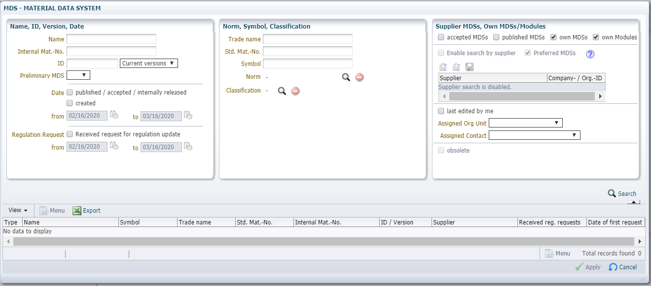
How to Create a Component in IMDS/CDX – STEP 3
For simple components, Click the Add Material Reference icon.
For complex components, Click the Add Component or Semi-component Reference
A new search window will open.

Slide 12
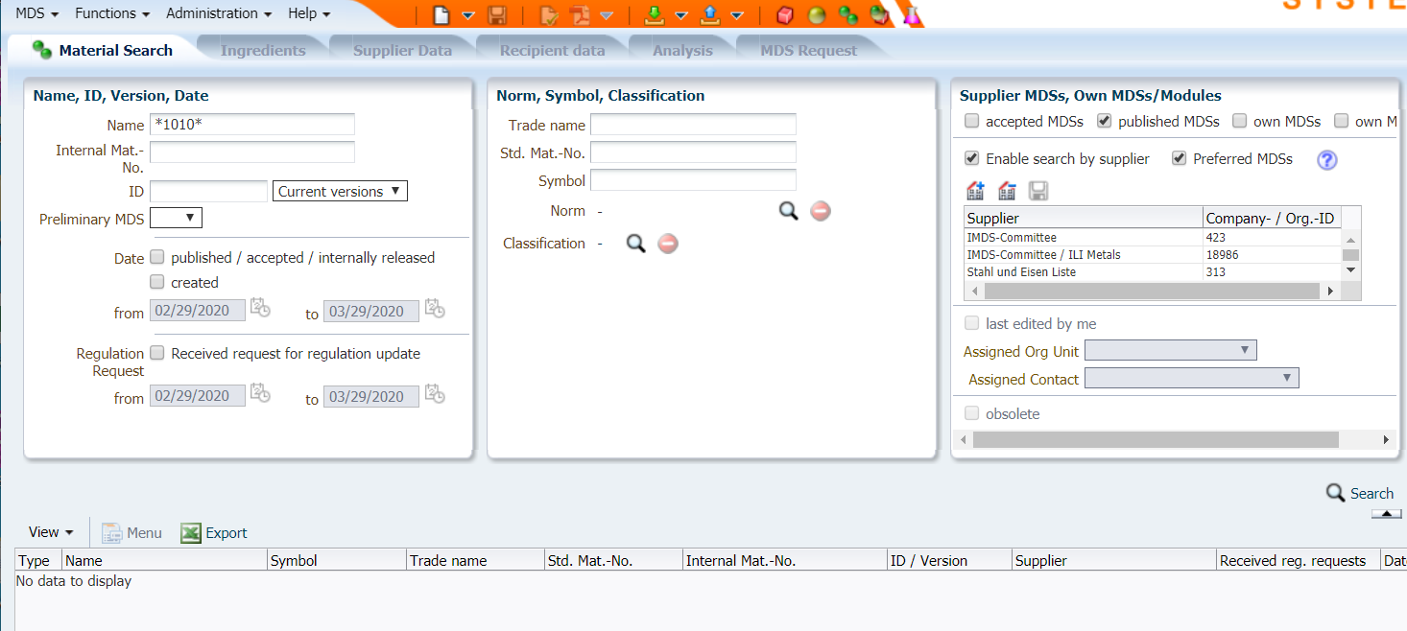
How to Create a Component in IMDS/CDX – STEP 4
Options for adding a material:
OPTION 1: Search for IMDS Committee published materials or CDX Standard Materials:
Under the “Supplier MDSs, Own MDSs/Modules” area uncheck the “accepted MDSs”, “own MDSs”, and “own Modules”.
Check the “published MDSs” box, and the “Enable search by supplier box” (IMDS), or Check the “Standard MDSs” box (CDX)
Enter your search criteria in the appropriate field (s).
IMPORTANT: Searching with wildcards, i.e. *, before and after the will help you find the substance faster.
OPTION 2: Search for Internally created materials:
Under the “Supplier MDSs, Own MDSs/Modules” only check “own MDSs”.
Enter your search criteria in the appropriate field(s).
OPTION 3: Search for supplier Accepted materials:
Under the Supplier MDSs, Own MDS/Modules” only check “accepted MDSs”
Enter your search criteria in the appropriate field(s).
After selecting Option 1, 2, or 3, (or combination of Options) click “Search”. Highlight the material result and click “Apply”. Once applied, enter the weight of the material.

Slide 13
How to Create a Semi-Component in IMDS/CDX – STEP 1
OPTION 1:
Click the MDS dropdown menu:
Select > New > Datasheet (IMDS) > Semicomponent
OPTION 2:
Click on the blank page icon on the top banner and Select > Semicomponent
Click here, or here.

Slide 14
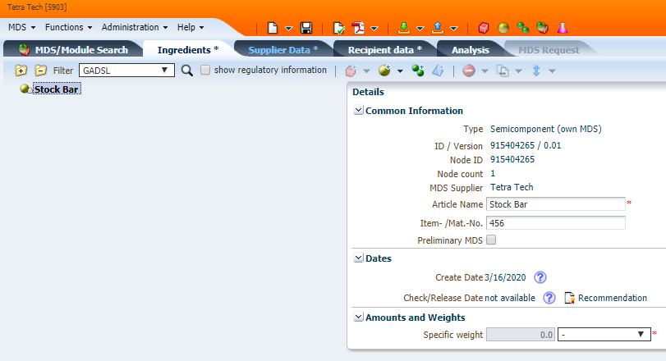
How to Create a Semi-Component in IMDS/CDX – STEP 2
Enter the Semicomponent “Article Name" in the “Description” field.
Click in the “Item- / Mat.-No./Item No.” (IMDS) field or the green + icon to enter your semi-component Company Part Number.
Use the pull-down to select the unit of measure and enter the Specific Weight.
Click on the Add Material Reference icon to add a material (as described in the How to Create a Component section)
After the material(s) is attached, enter the percent of each material used in the Semi-component.
Follow the same steps described in the How to Submit MDS to submit or internally release the datasheet.

Slide 15
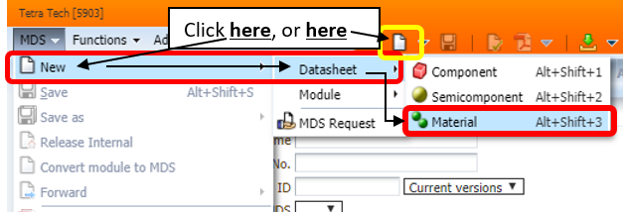
How to Create a Material in IMDS/CDX – STEP 1
NOTE: Before creating your own material, please check if there is an appropriate material
already published by the IMDS Steering Committee (IMDS) or as a Standard Material (CDX). In addition, you should NOT be creating a material if you are not the raw material manufacturer. The manufacturer should create the material and publish it OR submit it to your IMDS/CDX account.
OPTION 1:
Click the MDS dropdown menu:
Select > New > Datasheet > Material
OPTION 2:
Click on the blank page icon on the top banner and Select > Material

Slide 16
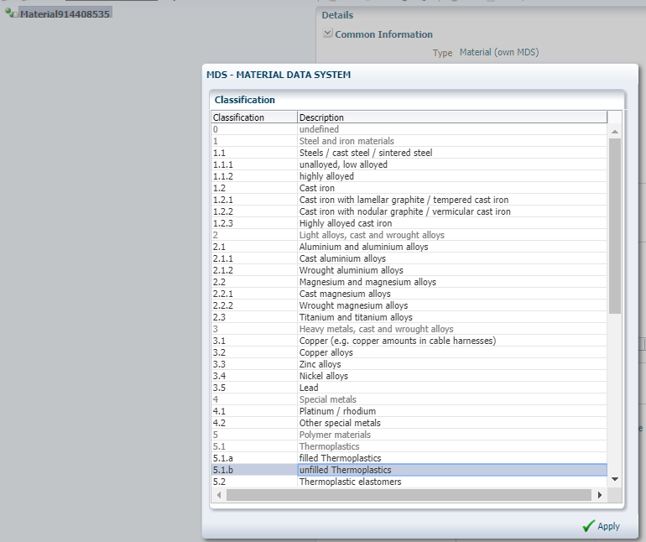
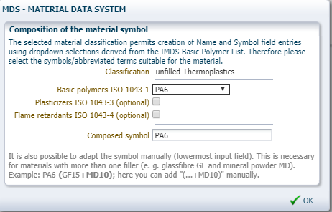
How to Create a Material in IMDS/CDX – STEP 2
Select the Material Classification
IMDS - From the pop-up window, select the type of material you wish to create from the material classification list. If selecting a polymeric classification, you may have to complete a second step before the material is created.
CDX – Click the green + symbol in the Classifications section of the datasheet.

Slide 17
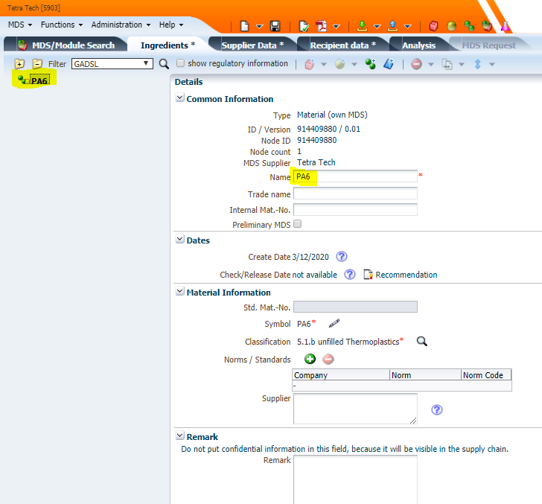
How to Create a Material in IMDS/CDX – STEP 3
Your material Material Data Sheet (MDS) is now created and ready to be filled out. Please note that the red * in the “Details” box, specifies that information must be filled in.
You can either keep the name of the material as generated from the previous process (IMDS) or you can edit it, as long as it still meets IMDS Recommendation 001.
You may also choose to enter the “Trade name” of the material you are creating.
Click the Add substance icon, to search for and Apply the substance(s) used in this material. Once applied, enter the percentage of the substance(s).
Make sure to follow IMDS Recommendation 001 with regards to max % unspecified substances (IMDS). No more than 10% will be allowed (IMDS/CDX)
Follow the same steps described in the How to Submit MDS to submit or internally release the datasheet.

Slide 18
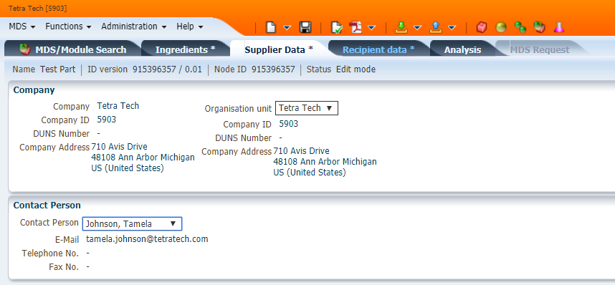
How to Submit MDS/CDX – STEP 1
Click on the “Supplier data*” tab on the top banner.
The “Company” information is prepopulated when the MDS is created.
Select the “Contact Person” from the dropdown selection box.

Slide 19
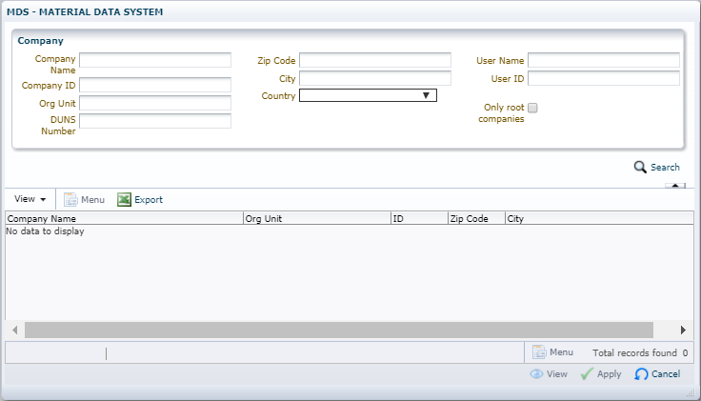
How to Submit MDS/CDX – STEP 2
Click on the “Recipient data*” tab to prepare your MDS for submission to your customer.
Click on the “Add recipient” icon
A new search window will open.
Note: If MDS is for internal use only (not being submitted to customer), click Release Internal to finalize the datasheet.
Enter the Walbro “Company ID” (IMDS ID 61252 or CDX ID 5147) and click “Search”.
Highlight the search result and click “Apply”

Slide 20
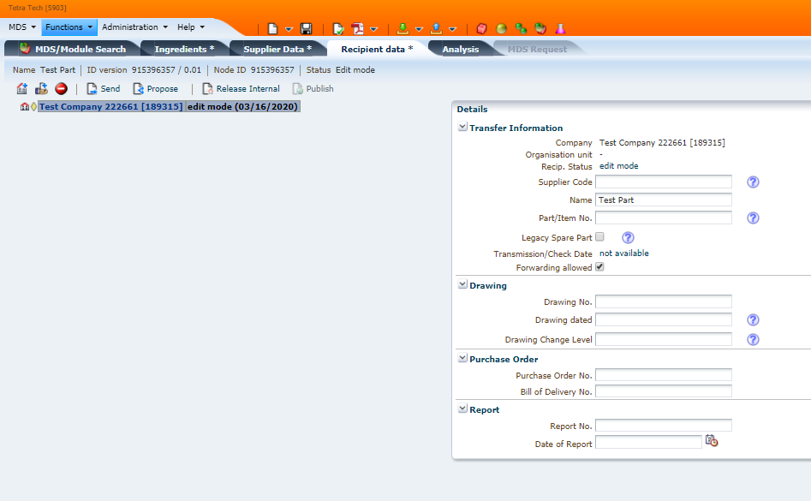
How to Submit MDS/CDX – STEP 3
The part name, “Name” will prepopulate based on the entry in the Ingredients tab. This field can be edited to reflect your customer’s specific name.
Enter your customer’s “Part / Item No.”
Note: The Name and Part/Item No. entered here is what your customer will see when they open the MDS and view the Ingredients tab. They WILL NOT see the Name and Part/Item No. you entered in your Ingredients tab.
Complete the other fields as required by your customer.
Click “Apply”
Click “Propose”
Note: Data must meet IMDS Recommendation 001 to ensure acceptance. This document is located under the Help pull-down. (IMDS)
For CDX: Keep in mind the following: Same symbol attached as same level, unspecified substances at or below 10%, Standard Materials when available. Each submission must be a full material declaration.

Slide 21
Additional Support
Tetra Tech offers turn-key IMDS/CDX project support. Please contact your Tetra Tech representative at walbro.productcompliance@Tetratech.com for details.
As of April 15, 2020, Tetra Tech also offers on-line IMDS Training (with CDX to be available soon). This is an 8 hour class that can be done on your own time, within a 30 days period. Note: IMDS and CDX are very similar, so attending IMDS training will still prove beneficial. Information regarding training may be found here…https://sustainable-markets.com/

